Slide 1
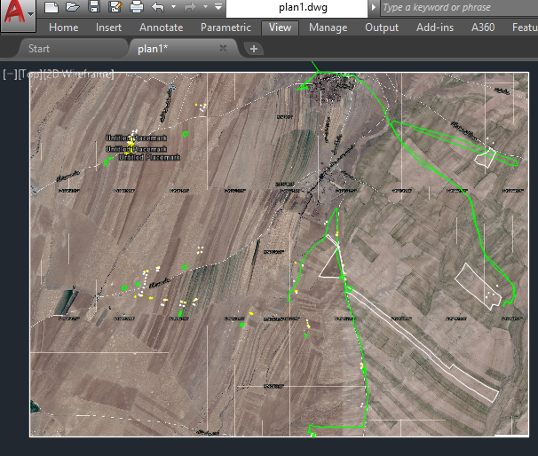
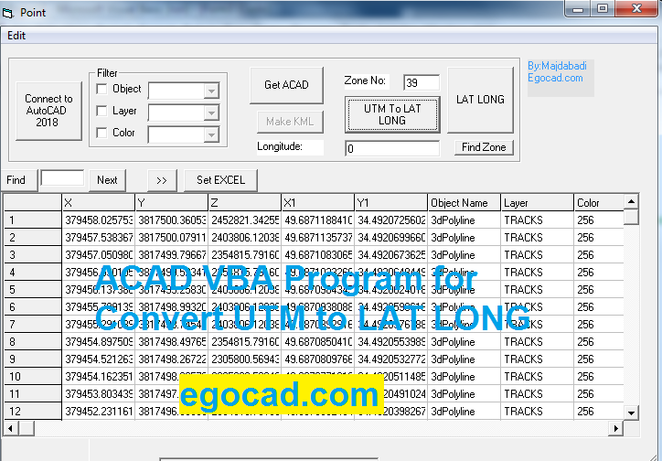
Convert UTM to Lat. Long.

Slide 2
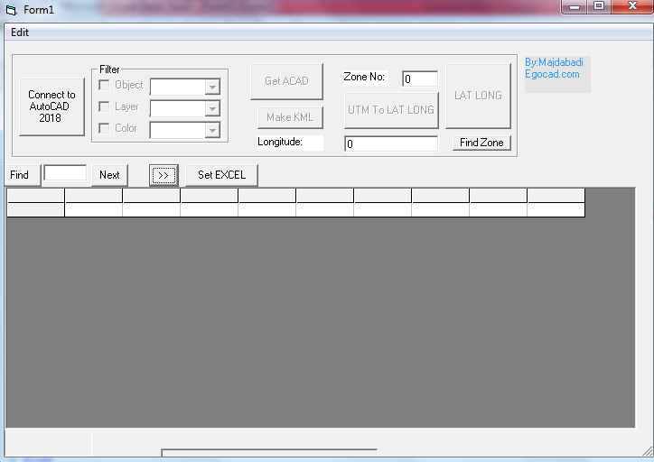
AutocadUTM.exe

Slide 3
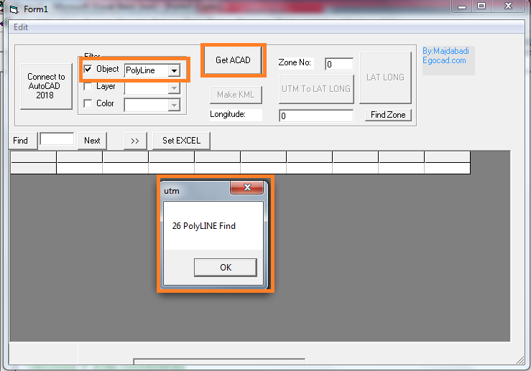
Click to Get ACAD

Slide 4
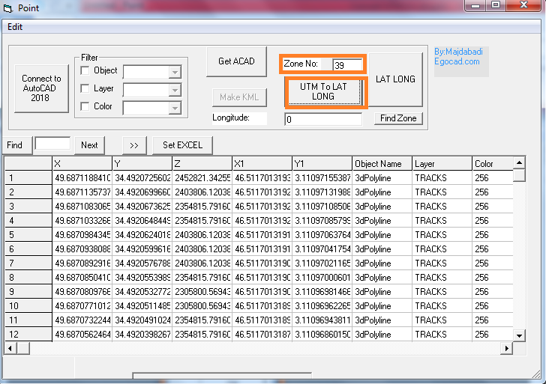
Click to UTM to LAT LONG

Slide 5
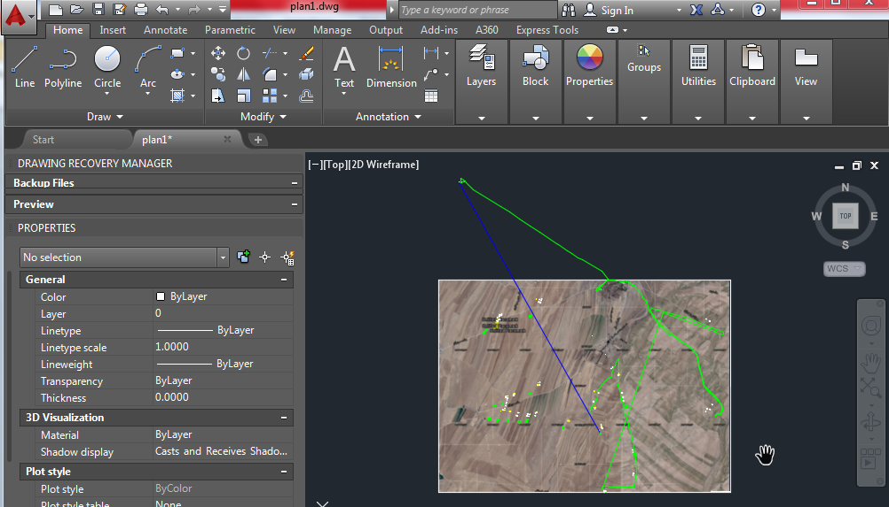
See Convert Cordinate in ACAD

Slide 6
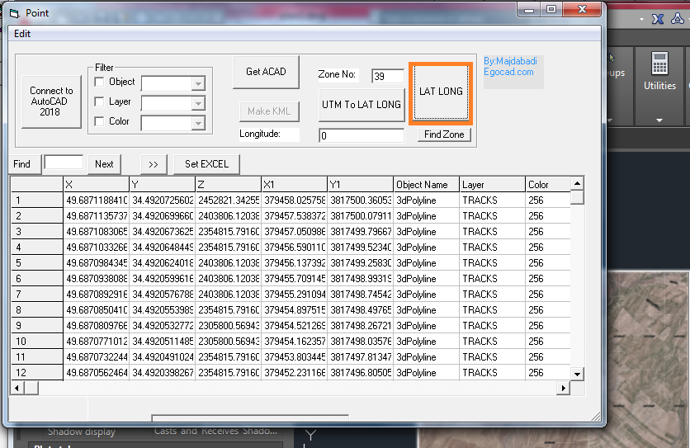
Click to LAT LONG for Convert to UTM

Slide 7
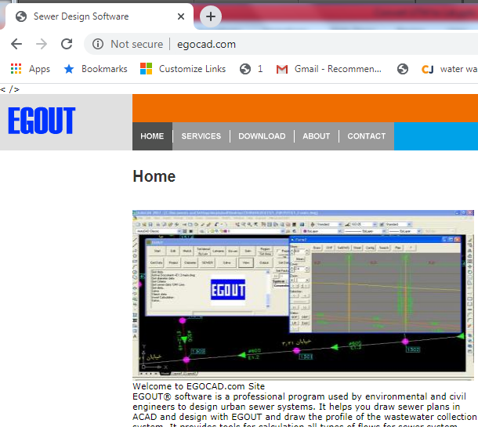
Download from egocad.com

