Slide 1
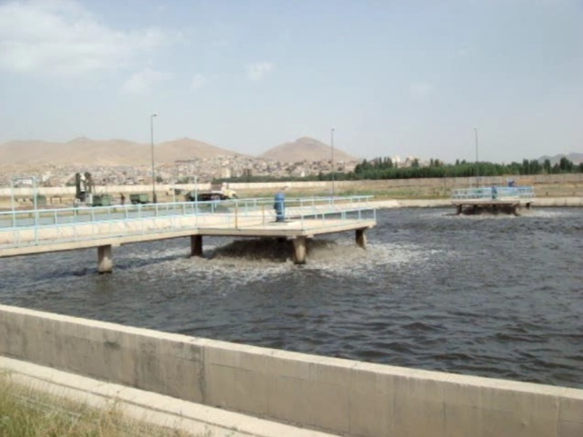
New Modification for Waste Water Treatment Plant
MTCR
Majd Time Cyclic Reactor
Mojtaba Mahmoudi Majdabadi
Ma. Environmental Health Eng.
Project Manager
Egocad.com
majdabadi83@gmail.com

Slide 2
Introdoction
Introduction
Introduction
Q & A

Slide 3
Wastewater reatment Systems & eqipment

Slide 4
History of Research
In the project “Saghez WWTP “while 50% of the construction works were proceeded our client requested us to revise the project from Aerated ponds to A2O process.
I had be redesign the WWTP and change a steam line that contains 3 ponds with a series connection to 3 ponds with parallel connection to fit into A2O process.
In this experience I observed we can apply time cyclic operation in these ponds.

Slide 5
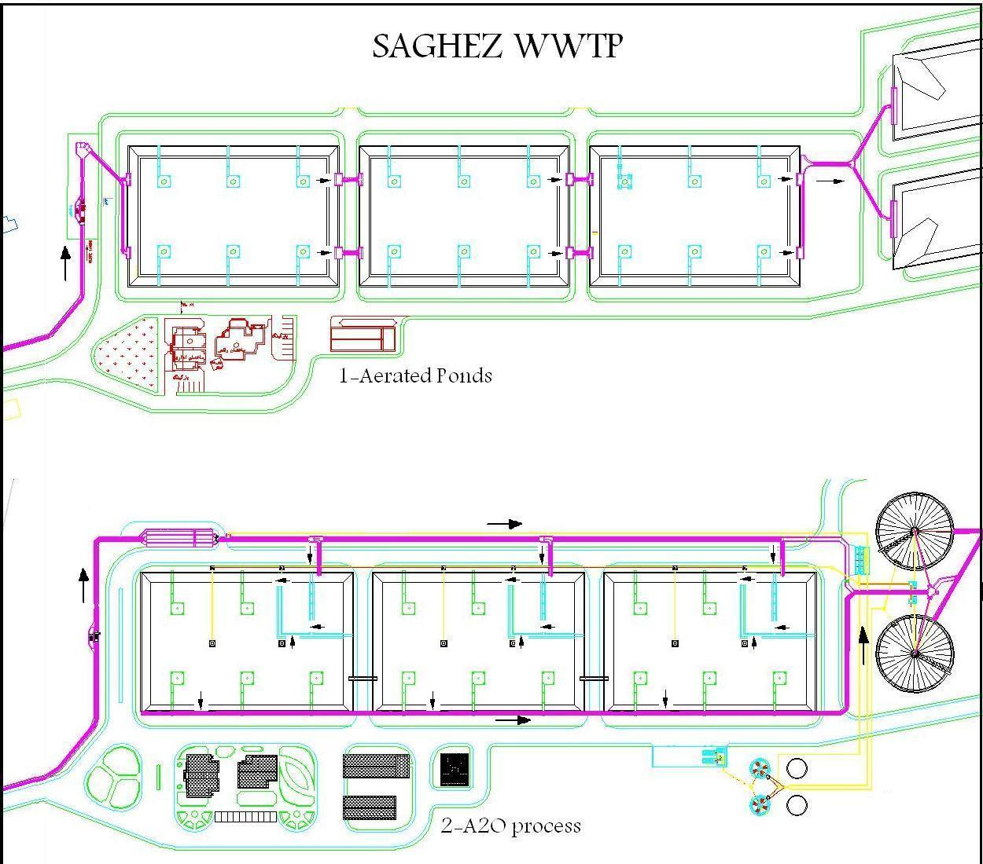
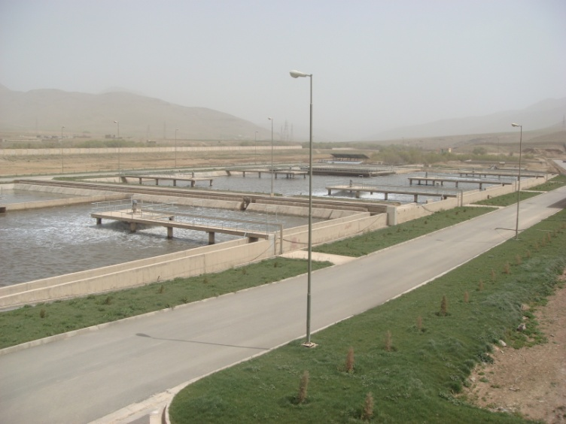

Slide 6
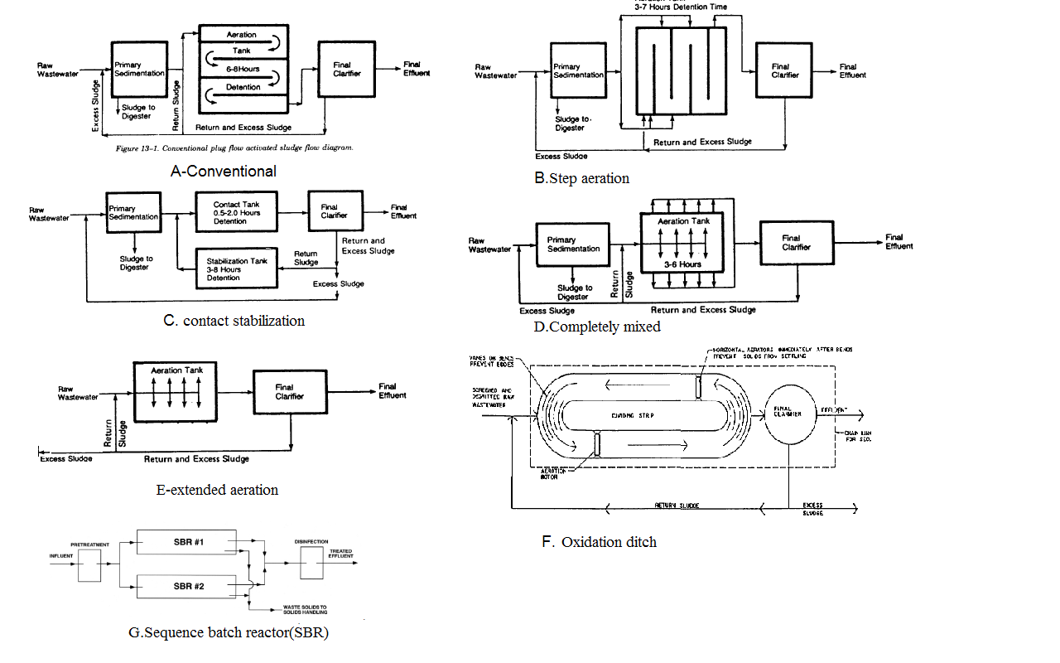
The important modifications of activated sludge

Slide 7
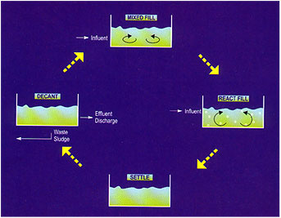
SBR Operation Philosophy
Sequencing Batch Reactor actually represent a process known as "Fill and Draw". The SBR reactor is a self-contained system incorporating equalization, aeration and clarification, within the confines of a SINGLE basin. Fill- During the fill phase, the basin receives influent wastewater. The influent brings food to the microbes in the activated sludge, creating an environment for biochemical reactions to take place.
React- During this phase, no wastewater enters the basin and the mechanical mixing and aeration units are on. Because there are no additional volume and organic loadings, the rate of organic removal increases dramatically. Most of the nitrogen and phosphorus are removed during this phase.
Settle- During this phase, activated sludge is allowed to settle- no flow enters the basin and no aeration or mixing take place.
Decant/Draw-During this phase, a decanter is used to remove the clear effluent located in the middle of the tank.
Idle-This step occurs between the decant and the fill phases. During this phase, a small amount of activated sludge at the bottom of the SBR basin is pumped out—a process called wasting.

Slide 8
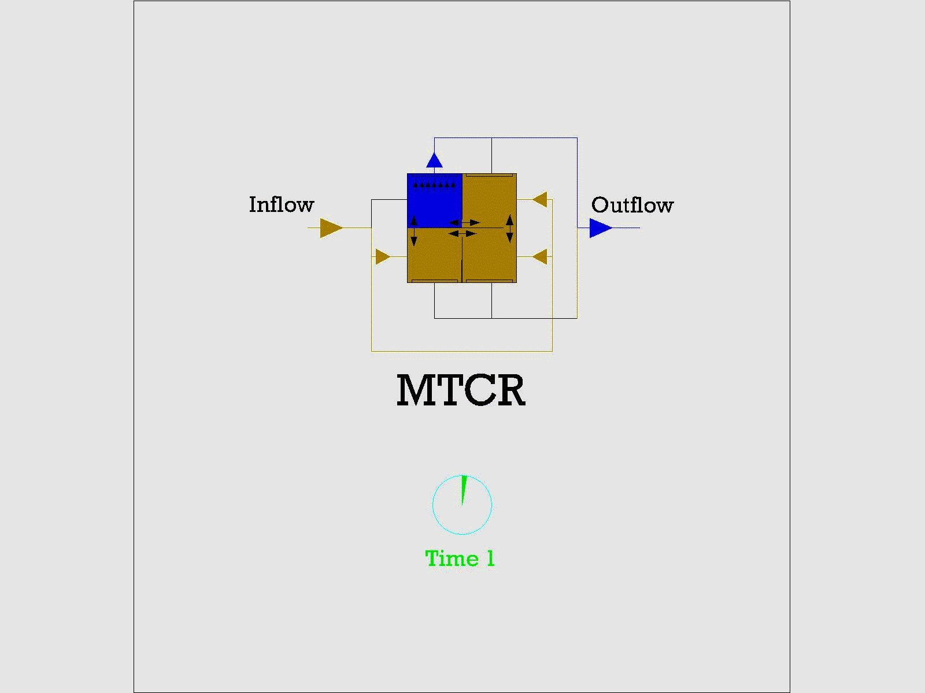
Majd Time Cyclic Reactor
MTCR is a continues flow suspended growth process (activated sludge) in which all major applied steps occur in the one tank with four compartments in a timing cyclic order

Slide 9
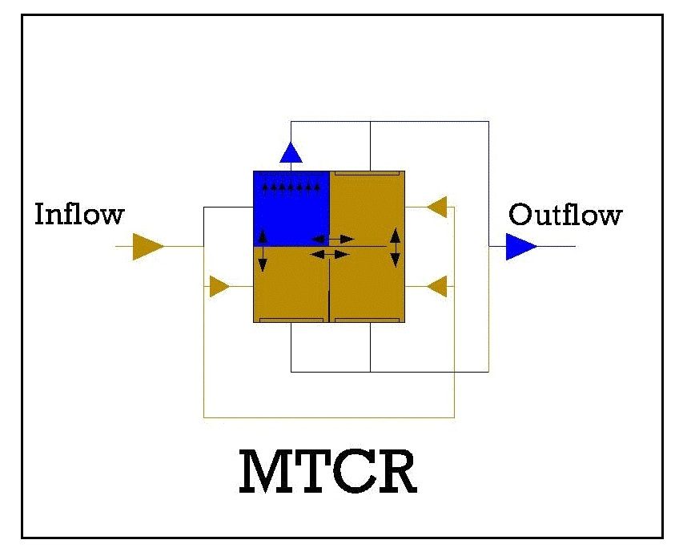
Majd Time Cyclic Reactor
Continues flow condition
Suspended grows condition and
Activated sludge process
A tank with 4 compartments (typical)
Valves in tank inlets and outlets
Blowers and diffusers for aeraotion
Mixers for mixing of liquors
Pumps for discharging excess sludge
PLC for controlling and coordinating of process steps and cycle events

Slide 10
MTCR Events
React ,take in 3-4 or 6 hours
Settle ,take in 15-20 minutes
Draw, take in 3-4 or 6 hours

