Slide 1
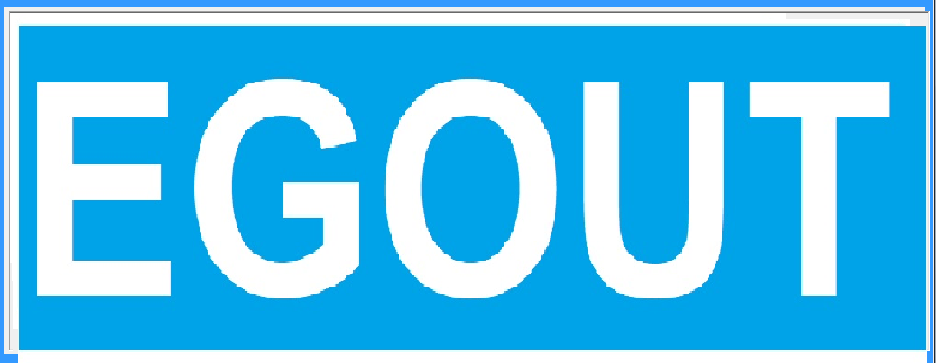
EGOUT, Sewer Design Software
Egocad.com

Slide 2
Click on Start for connect to Autocad

Slide 3
Draw Line as sewer in Autocad

Slide 4
Insert Endblock on endpoint(s)

Slide 5
Click on edit

Slide 6
Click on Match

Slide 7
Click to bylen for set lateral

Slide 8
Click on mhname for manhole name

Slide 9
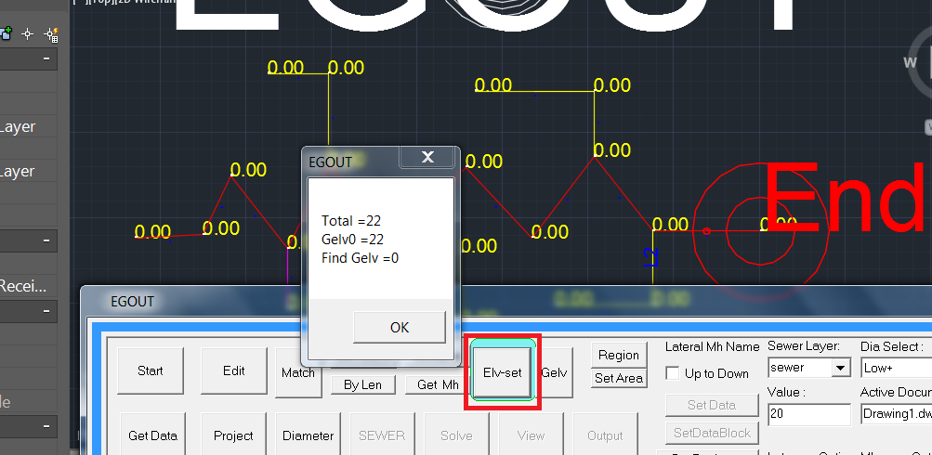
Click on elvset for grund elevation set

Slide 10
Click on gelv for set elv to sewer lines

Slide 11
Set lyer area-desity to current

Slide 12
Draw area zone line

Slide 13
Click to region for sewer area definition

Slide 14
Click to getdata

Slide 15
Click on project criteria and set mincover

Slide 16
Click on solve

Slide 17
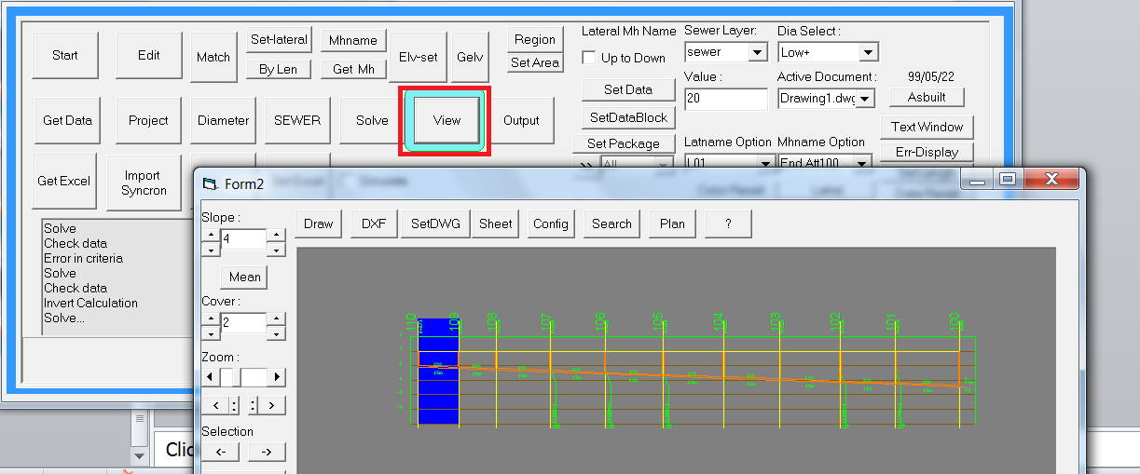
Click on view

Slide 18
On profile design

Slide 19
SDF-slope defined by user

Slide 20
DDF, Diameter defined by user

Slide 21
Lift station

Slide 22
Mean slope for selection

Slide 23
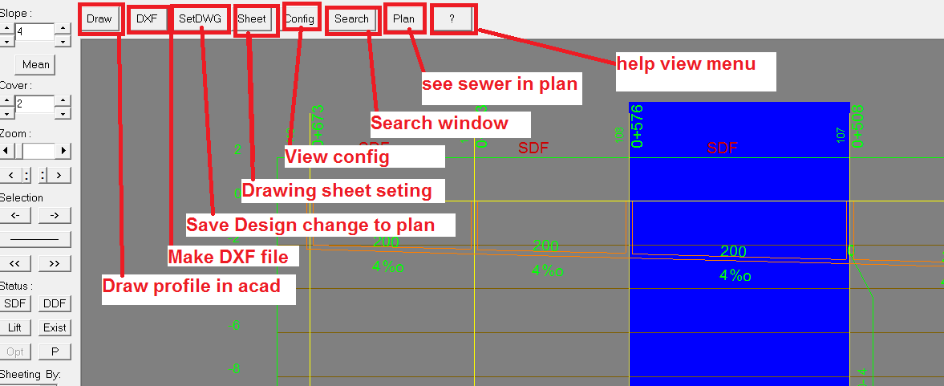
Top menu

Slide 24
Draw plan and profile in autocad

Slide 25
Plan and profile

